Slide 1


DATA COMMUNICATION
CSE 225/233
WEEK-2, LESSON-1
NETWORK MODEL

Slide 2


















































Layered Task
We use the concept of layers in our daily life. As an example, let us consider two friends who communicate through postal mail. The process of sending a letter to a friend would be complex if there were no services available from the post office. See the next slide.

Slide 3
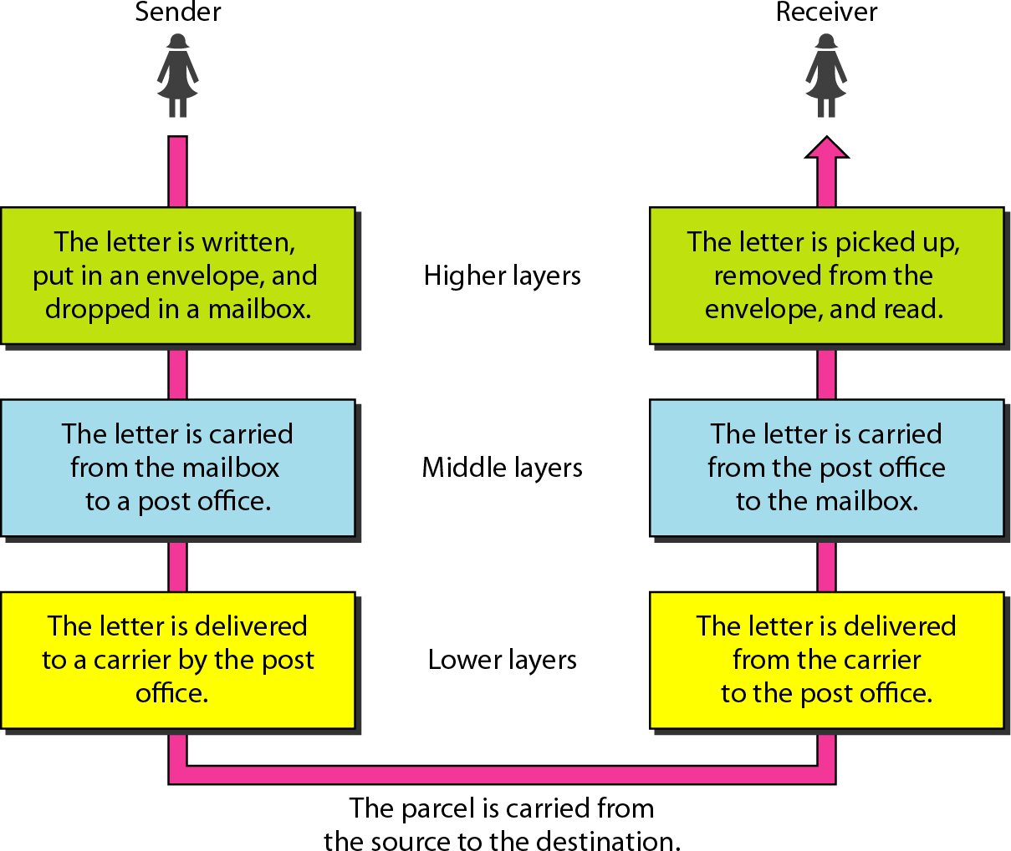
Tasks involved in sending a letter

Slide 4











































The OSI model
Established in 1947, the International Standards Organization (ISO) is a multinational body dedicated to worldwide agreement on international standards. An ISO standard that covers all aspects of network communications is the Open Systems Interconnection (OSI) model. It was first introduced in the late 1970s.

Slide 5
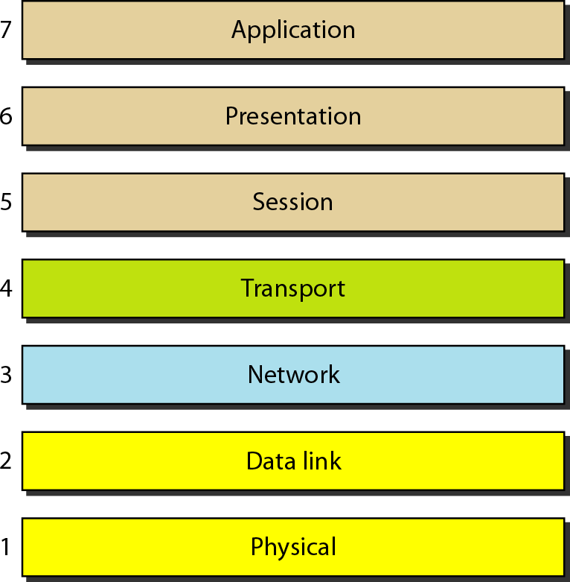
Layers of the OSI model

Slide 6
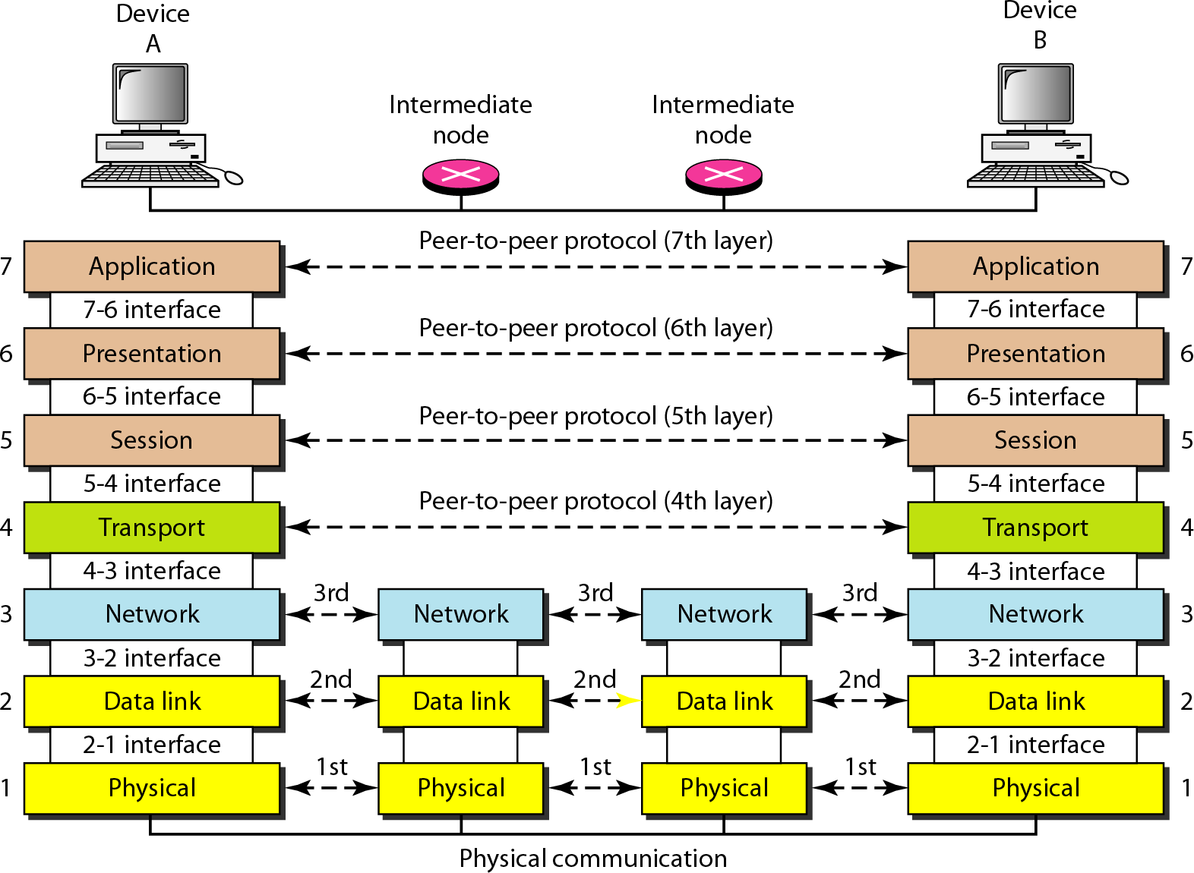
The OSI model

Slide 7
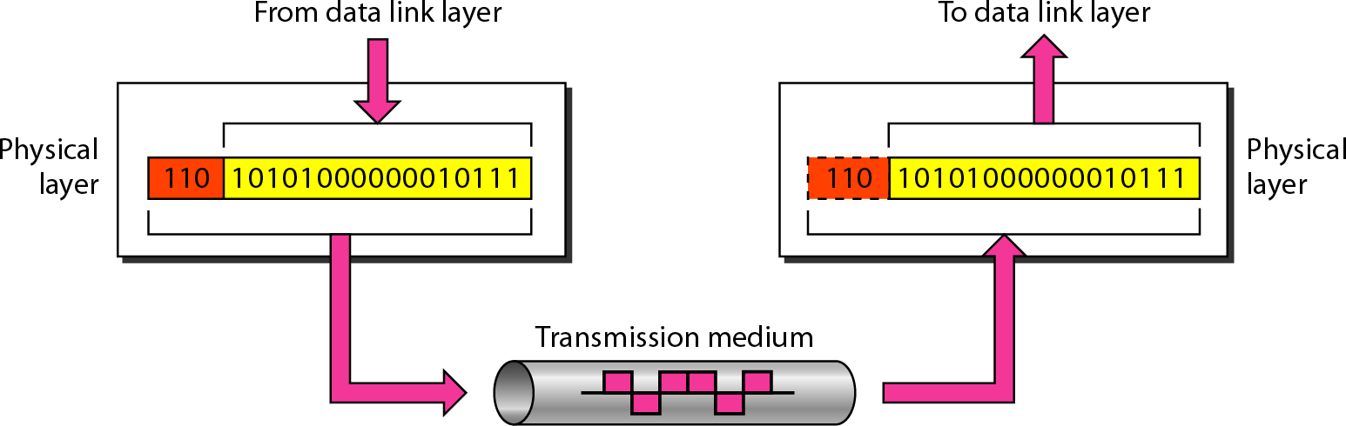
Physical Layer

Slide 8
Functionalities of Physical Layer
Following are the various functions performed by the Physical layer of the OSI model.
Representation of Bits: Data in this layer consists of stream of bits. The bits must be encoded into signals for transmission. It defines the type of encoding i.e. how 0's and 1's are changed to signal.
Data Rate: This layer defines the rate of transmission which is the number of bits per second.
Synchronization: It deals with the synchronization of the transmitter and receiver.
The sender and receiver are synchronized at bit level.
Interface: The physical layer defines the transmission interface between devices and transmission medium.
Line Configuration: This layer connects devices with the medium: Point to Point configuration and Multipoint configuration.
Topologies: Devices must be connected using the following topologies: Mesh, Star, Ring and Bus.
Transmission Modes: Physical Layer defines the direction of transmission between two devices: Simplex, Half Duplex, Full Duplex.
Deals with baseband and broadband transmission.

Slide 9
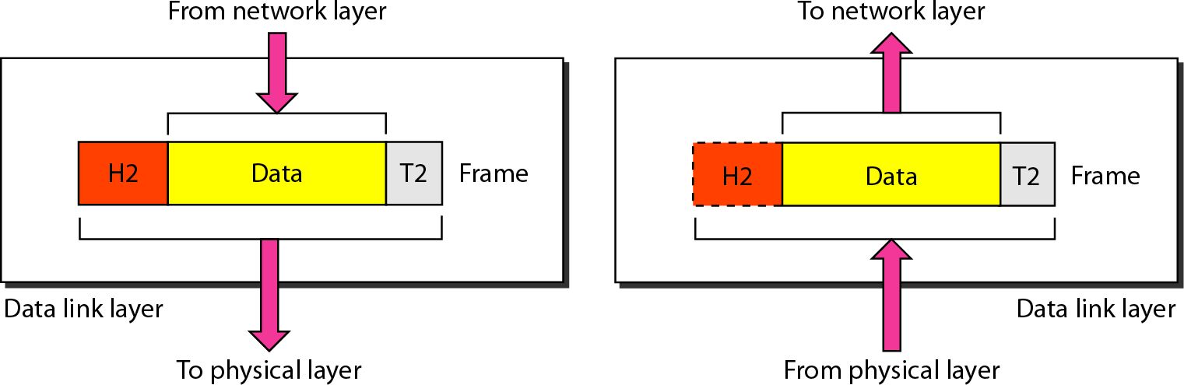
Data Link Layer

Slide 10
Functionalities of Datalink Layer
Following are the various functions performed by the Datalink layer of the OSI model.
Framing: Frames are the streams of bits received from the network layer into
manageable data units. This division of stream of bits is done by Data Link Layer.
Physical Addressing: The Data Link layer adds a header to the frame in order to define physical address of the sender or receiver of the frame, if the frames are to be distributed to different systems on the network.
Flow Control: A flow control mechanism to avoid a fast transmitter from running a slow receiver by buffering the extra bit is provided by flow control. This prevents traffic jam at the receiver side.
Error Control: Error control is achieved by adding a trailer at the end of the frame. Duplication of frames are also prevented by using this mechanism. Data Link Layers adds mechanism to prevent duplication of frames.
Access Control: Protocols of this layer determine which of the devices has control over the link at any given time, when two or more devices are connected to the same link.

Slide 11
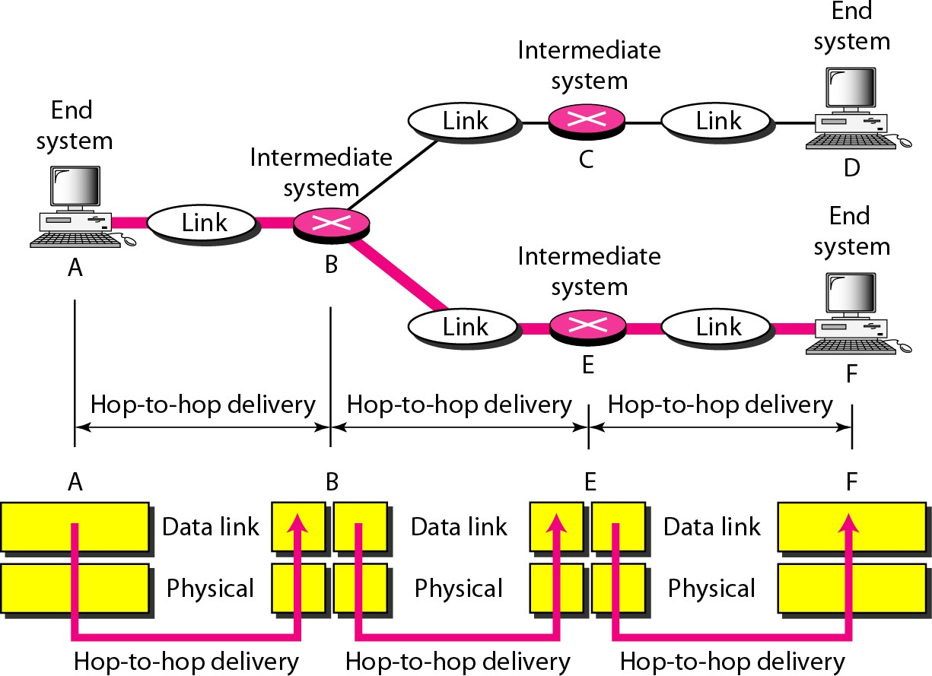
Hop to Hop delivery

Slide 12
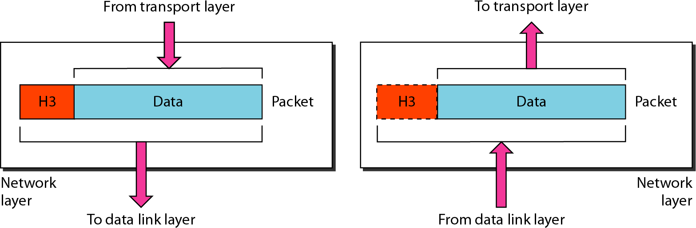
Network Layer

Slide 13
Functionalities of Network Layer
Following are the various functions performed by the network layer of the OSI model.
It translates logical network address into physical address. Concerned with circuit, message or packet switching.
Routers and gateways operate in the network layer. Mechanism is
provided by Network Layer for routing the packets to final destination.
Connection services are provided including network layer flow control, network layer error control and packet sequence control.
Breaks larger packets into small packets.

Slide 14
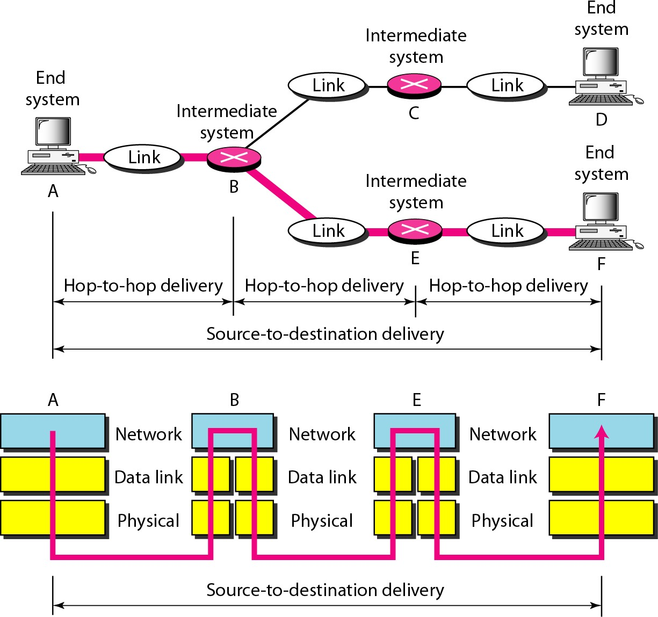
Source to Destination delivery

Slide 15
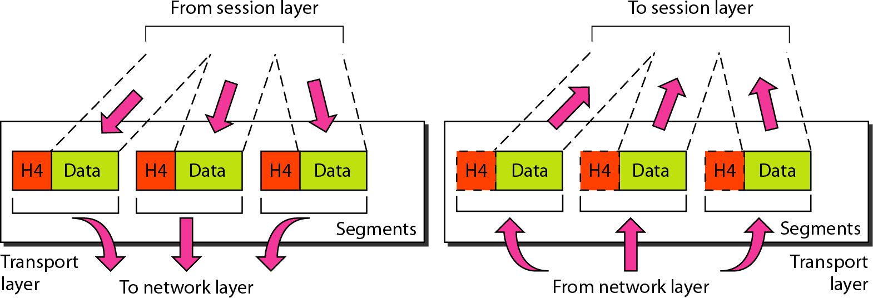
Transport Layer

Slide 16
Functionalities of Transport Layer
Following are the various functions performed by the Transport layer of the OSI model.
Service Point Addressing: Transport Layer header includes service point address which is port address. This layer gets the message to the correct process on the computer unlike Network Layer, which gets each packet to the correct computer.
Segmentation and Reassembling: A message is divided into segments; each segment contains sequence number, which enables this layer in reassembling the message. Message is reassembled correctly upon arrival at the destination and replaces packets which were lost in transmission.
Connection Control: It includes 2 types:
Connectionless Transport Layer : Each segment is considered as an independent packet and delivered to the transport layer at the destination machine.
Connection Oriented Transport Layer : Before delivering packets, connection is made with transport layer at the destination machine.
Flow Control: In this layer, flow control is performed end to end.
Error Control: Error Control is performed end to end in this layer to ensure that the complete message arrives at the receiving transport layer without any error. Error Correction is done through retransmission.

Slide 17
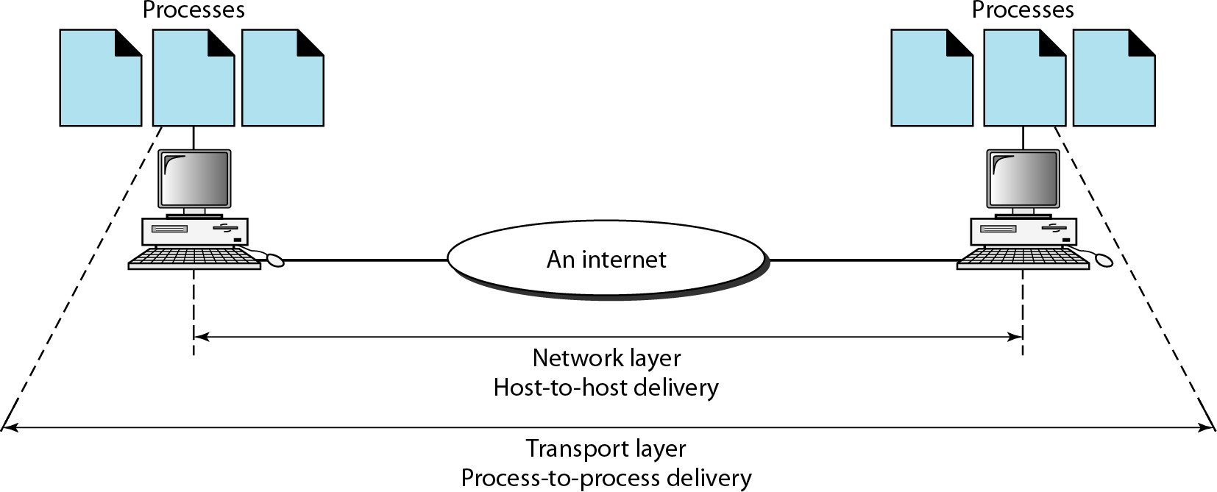
Process to Process delivery of a message

Slide 18
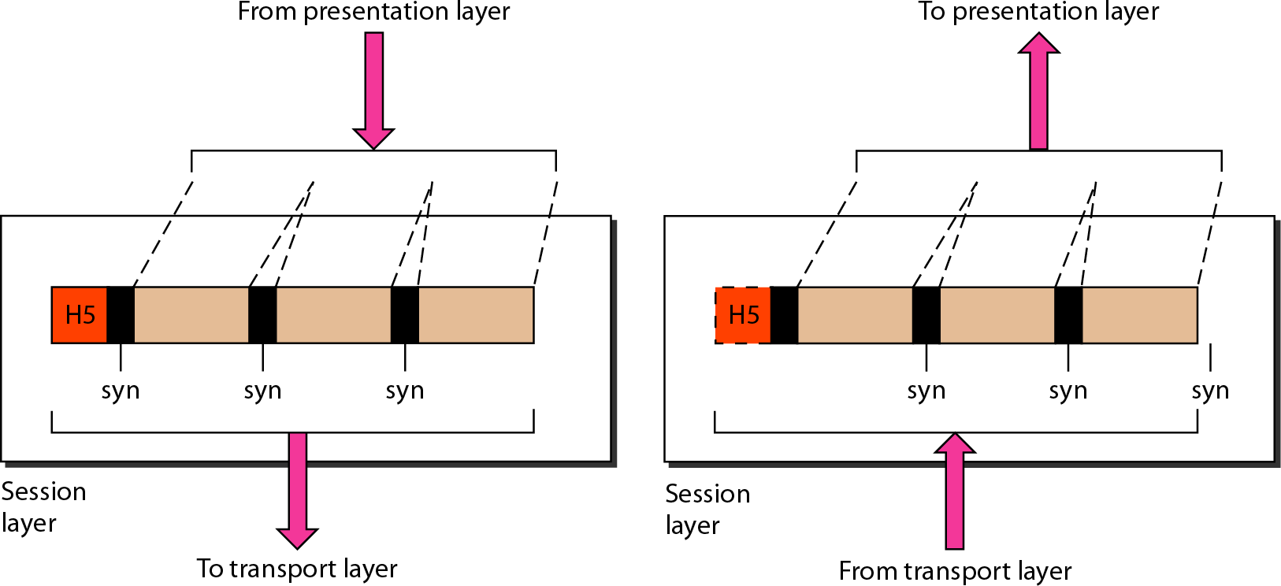
Session Layer

Slide 19
Functionalities of Session Layer
Following are the various functions performed by the session layer of the OSI model.
Dialog Control : This layer allows two systems to start communication with each other in half-duplex or full-duplex.
Token Management: This layer prevents two parties from attempting the
same critical operation at the same time.
Synchronization : This layer allows a process to add checkpoints which are considered as synchronization points into stream of data. Example: If a system is sending a file of 800 pages, adding checkpoints after every 50 pages is recommended. This ensures that 50 page unit is successfully received and acknowledged. This is beneficial at the time of crash as if a crash happens at page number 110; there is no need to retransmit 1 to100 pages.

Slide 20
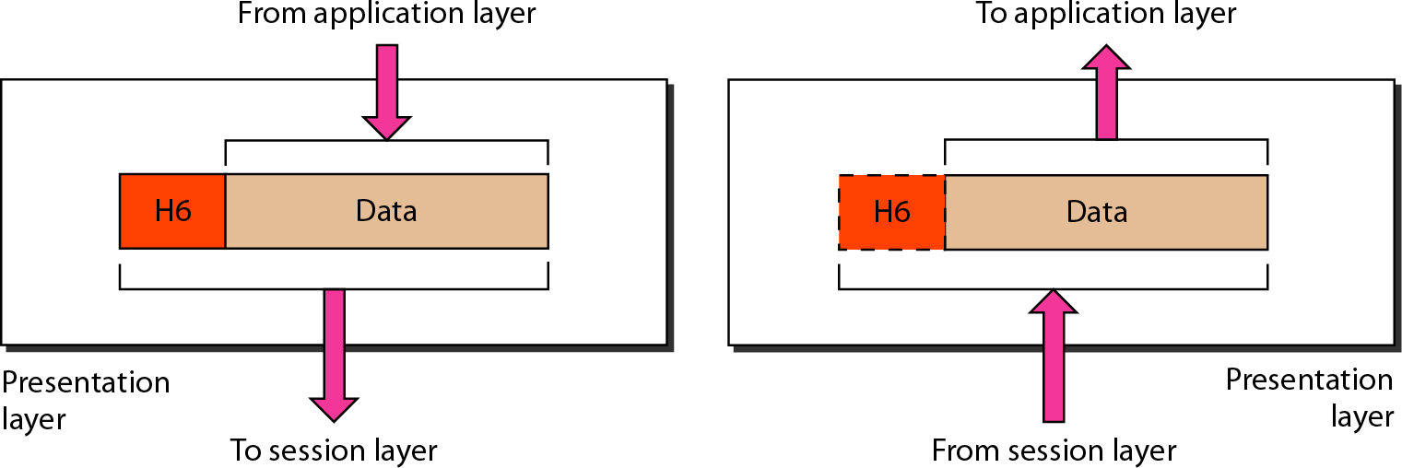
Presentation Layer

Slide 21
Functionalities of Presentation Layer
Following are the various functions performed by the presentation layer of the OSI model.
Translation: Before characters and
being transmitted, information in the form of
numbers should be changed to bit streams. The
presentation layer is responsible for interoperability between encoding methods as different computers use different encoding methods. It translates data between the formats the network requires and the format the computer.
Encryption: It carries out encryption at the transmitter and decryption at the receiver.
Compression: It carries out data compression to reduce the bandwidth of the data to be transmitted. The primary role of Data compression is to reduce the number of bits to be 0transmitted. It is important in transmitting multimedia such as audio, video, text etc.

Slide 22
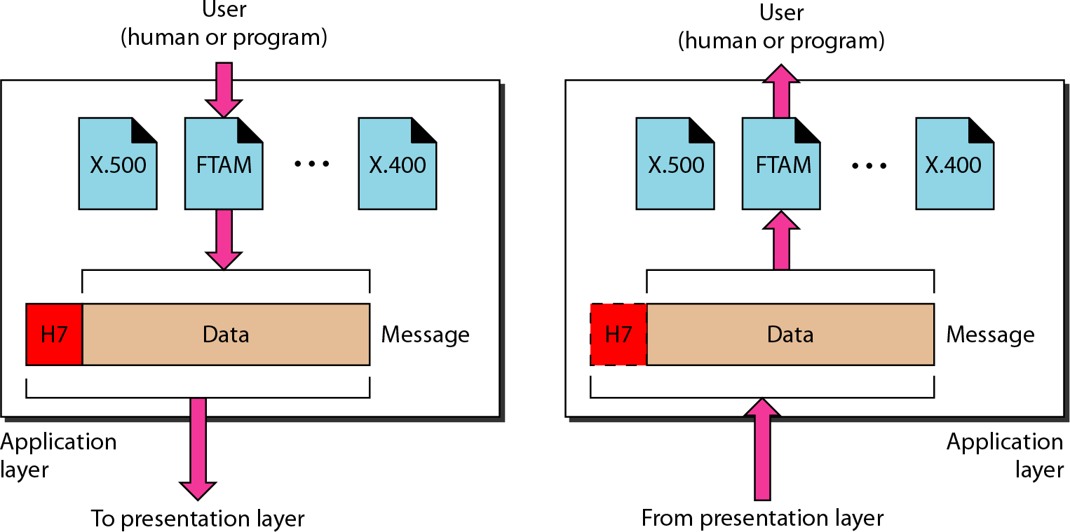
Application Layer

Slide 23
Functionalities of Application Layer
Following are the various functions performed by the application layer of the OSI model.
Mail Services: This layer provides the basis for E-mail forwarding and
storage.
Network Virtual Terminal: It allows a user to log on to a remote host. The application creates software emulation of a terminal at the remote host. User's computer talks to the software terminal which in turn talks to the host and vice versa. Then the remote host believes it is communicating with one of its own terminals and allows user to log on.
Directory Services: This layer provides access for global information about various services.
File Transfer, Access and Management (FTAM): It is a standard mechanism to access files and manages it. Users can access files in a remote computer and manage it. They can also retrieve files from a remote computer.

Slide 24
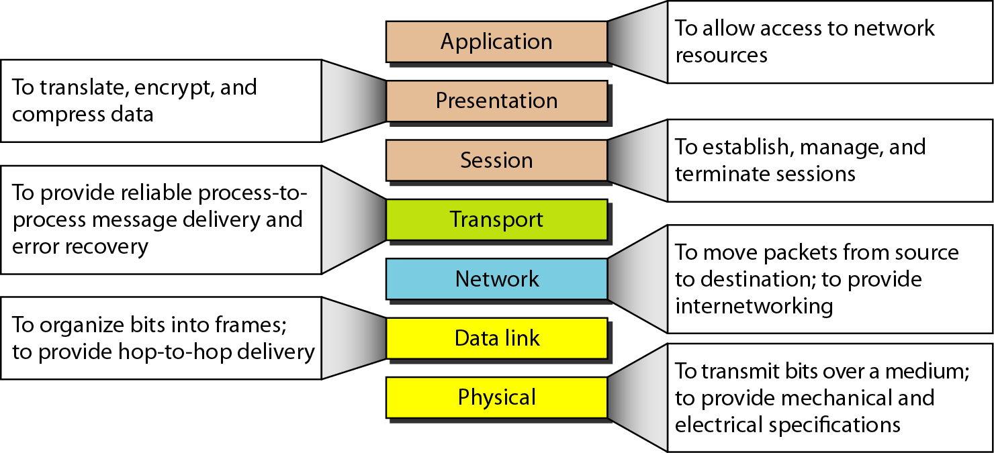
Summary of the layers

Slide 25
Exercises
Go through the exercises given at the end of the chapter. Note that, we are following the 4th Edition of Forouzan Book for this chapter.

Slide 26


